Slide 1
DSO510 Project 2
Cheng CHEN, Cheng ZHANG, Jie CHEN,
Mi ZHONG, Xinyu LIANG, Yang LU, Yinghan LIU

Slide 2
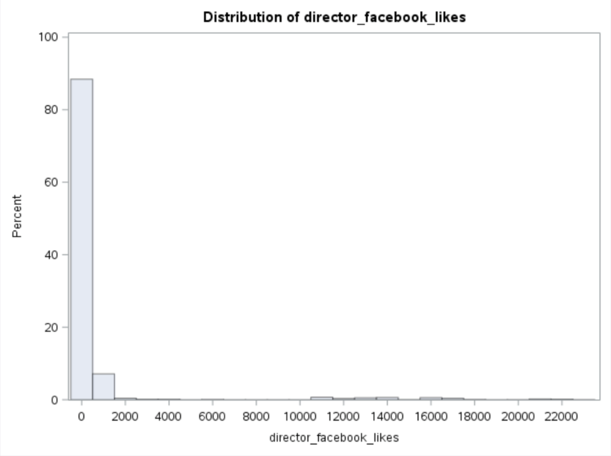
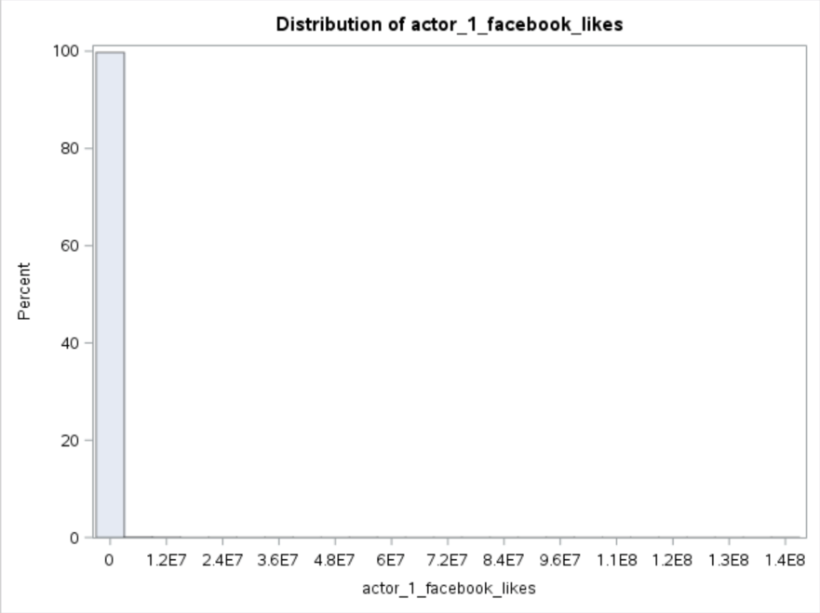
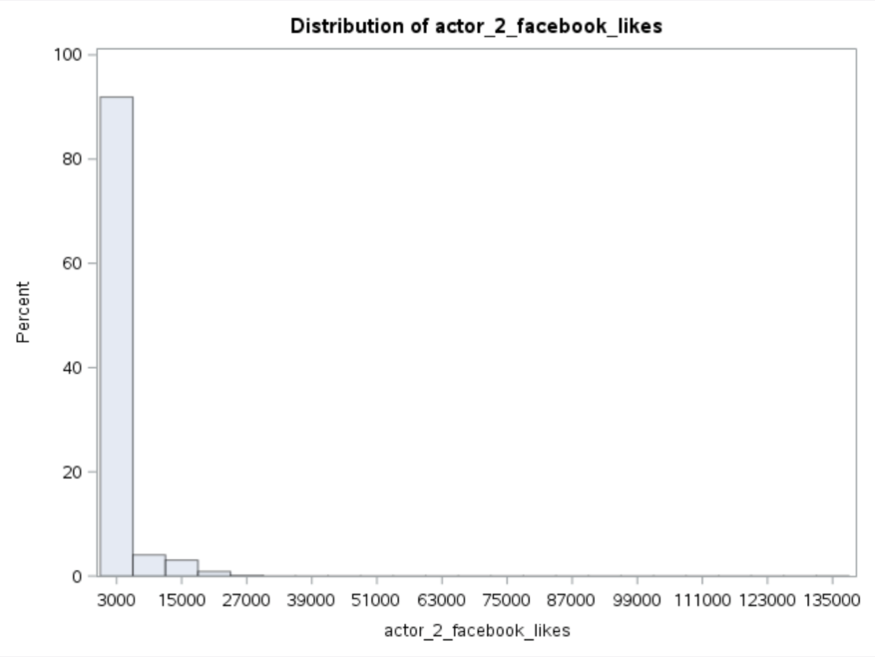
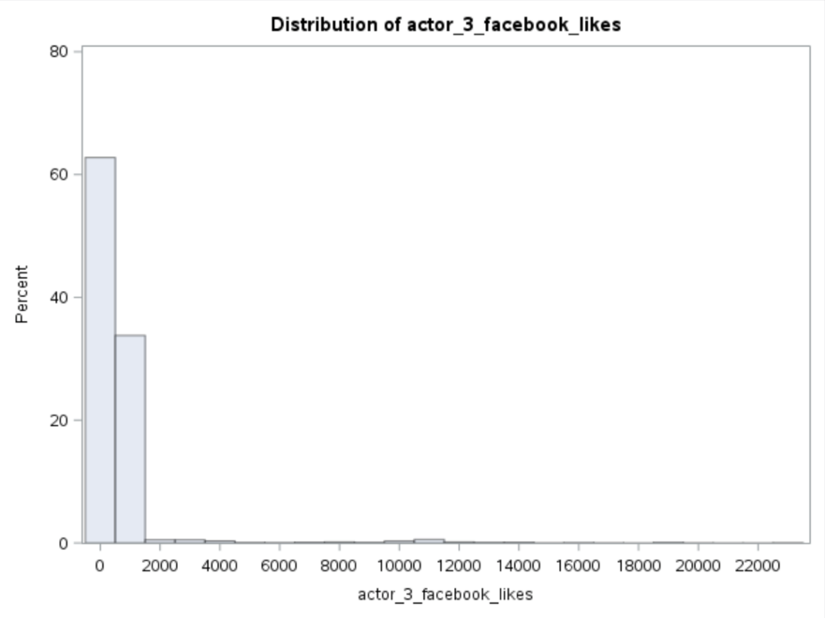
What‘s New?
Step 1
Data Source is not plausible
Web scraping to improve source data
Notes:
What’s new here?
Here we make some changes of our data.
First, looking at the four figures, which comes from our source data.
This distributions of those data are not good so we decide to scrape data from web to improve the qualify of source data.

Slide 3
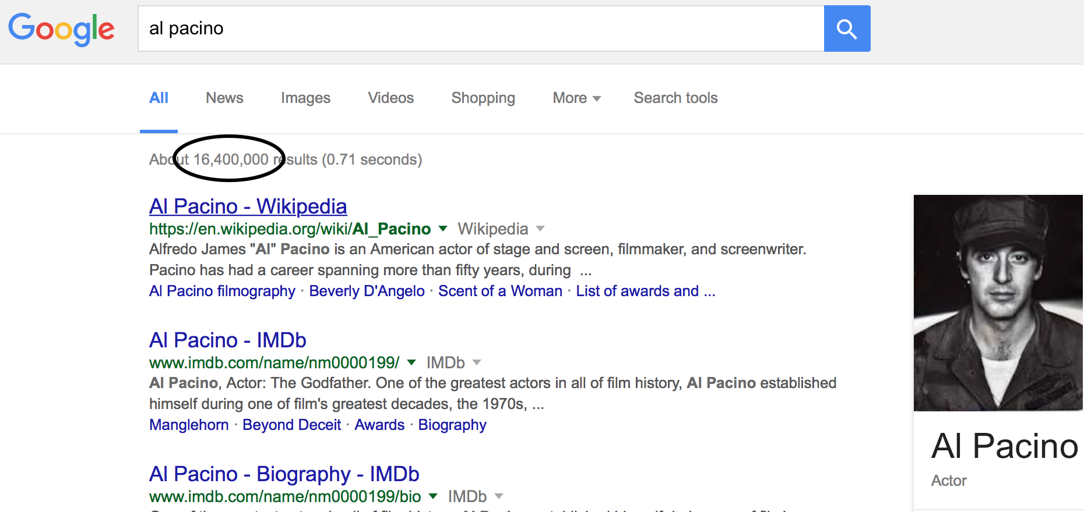
What‘s New?
 | Previous | Present
Director | FB_likes | Google_results
Actor1 | FB_likes | Google_results
Actor2 | FB_likes | Google_results
Actor3 | FB_likes | Google_results
The data does not correspond to the Facebook. It is probably a set of indescribable data with a name of ”Facebook likes”
Notes:
The source data does not correspond to the Facebook. It is probably a set of indescribable data with a name of ”Facebook likes”.
As you can see from the left picture, we use those numbers to quantify the popularity of a director or an actor.

Slide 4
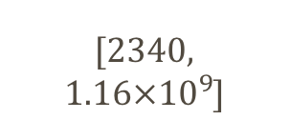
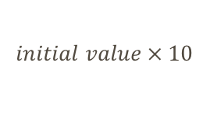
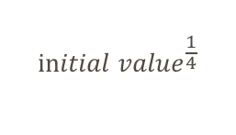
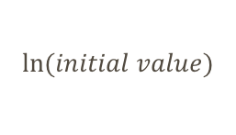
What‘s New?
Variable
Initial
[Min, Max]
After Step 2
[Min, Max]
Step 2
Duration
[41, 300]
[0.683, 5.00]
Min→Hour
Using mapping to decrease the magnitude of data
Director Google Results
[2340, $1.16×{10}^{9}$]
[7.76, 20.87]
$$\ln{(initial value)}$$
Gross/Budget
[0, 7194]
[0, 9.21]
$${initial value}^{\frac{1}{4}}$$
Transfer them to the range of [0, 100]
Actor1/Total Cast FB Likes
[0.14, 1]
[1.41, 10]
$$initial value × 10$$
Reduce the influence of computing rounding error during calculation
Also apply to other variables such as Budget, Num Critics for Reviews, Actor 1/2/3 FB Likes, Actor 1/2/3 Google Results ...
Notes:
And then, we use one-to-one mapping to decrease the magnitude of our data. We apply functions to realize the one-to-one mapping and by doing this new data will not lose its nature.
We transfer them to the range of [0, 100] so as to facilitate those calculation of data including linear regression and binary logistic regression.
And the advantage here is that the computer no longer needs to deal with very large data and very small data in a single calculation and therefore reduce the influence of computing rounding error during calculation.

Slide 5
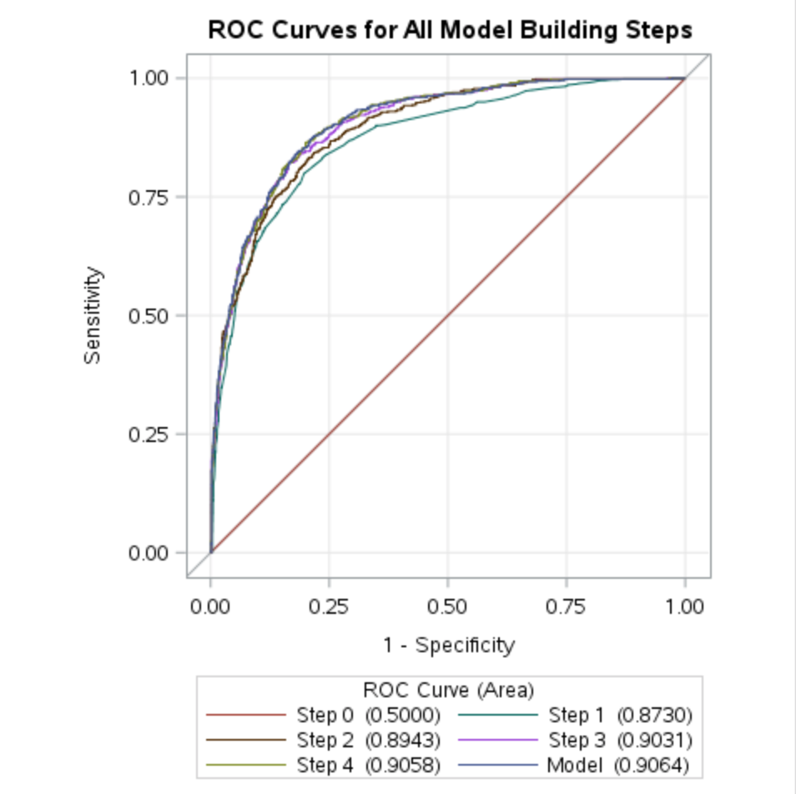
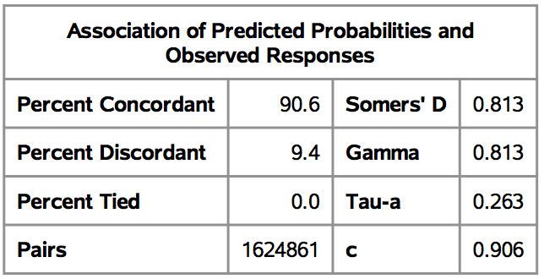
Gross Box Office Binary Logistic Regression
Highest Grossing Movie
Threshold: Gross Box > $70,000,000 (top 20% of dataset)
Area under the curve 0.9064

Slide 6
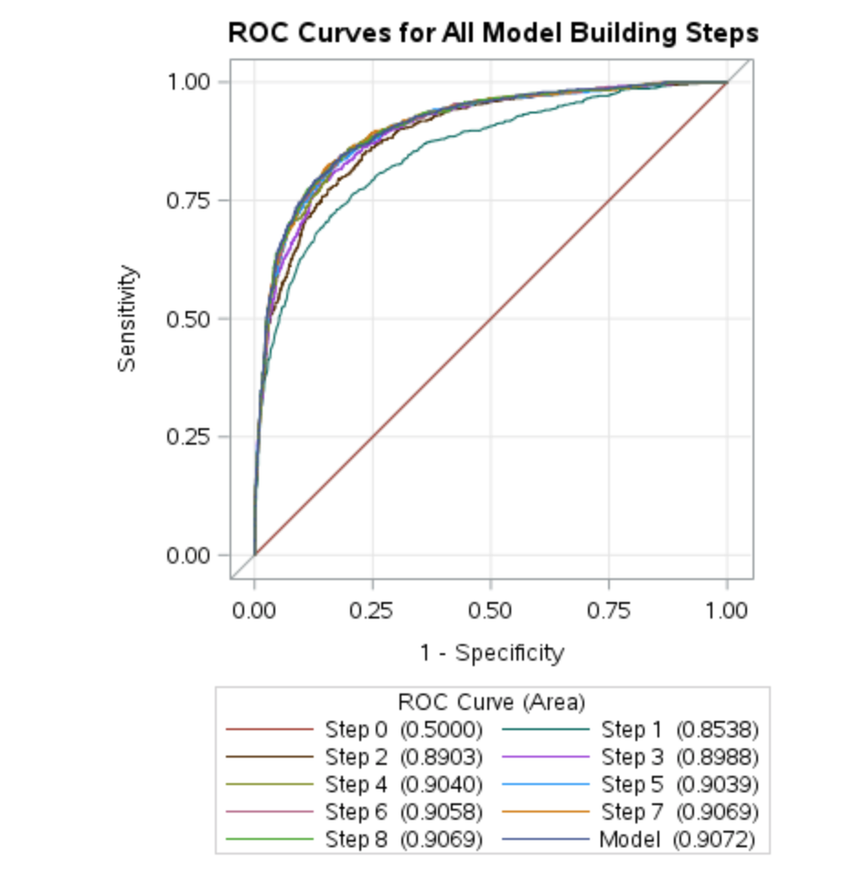
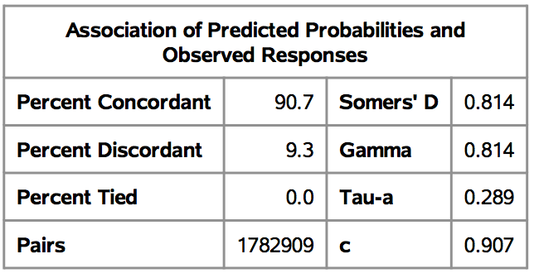
Gross Box Office Binary Logistic Regression
The Black Hole
Threshold: Gross Box < $1,000,000 (last 25% of dataset)
Area under the curve 0.9072

Slide 7
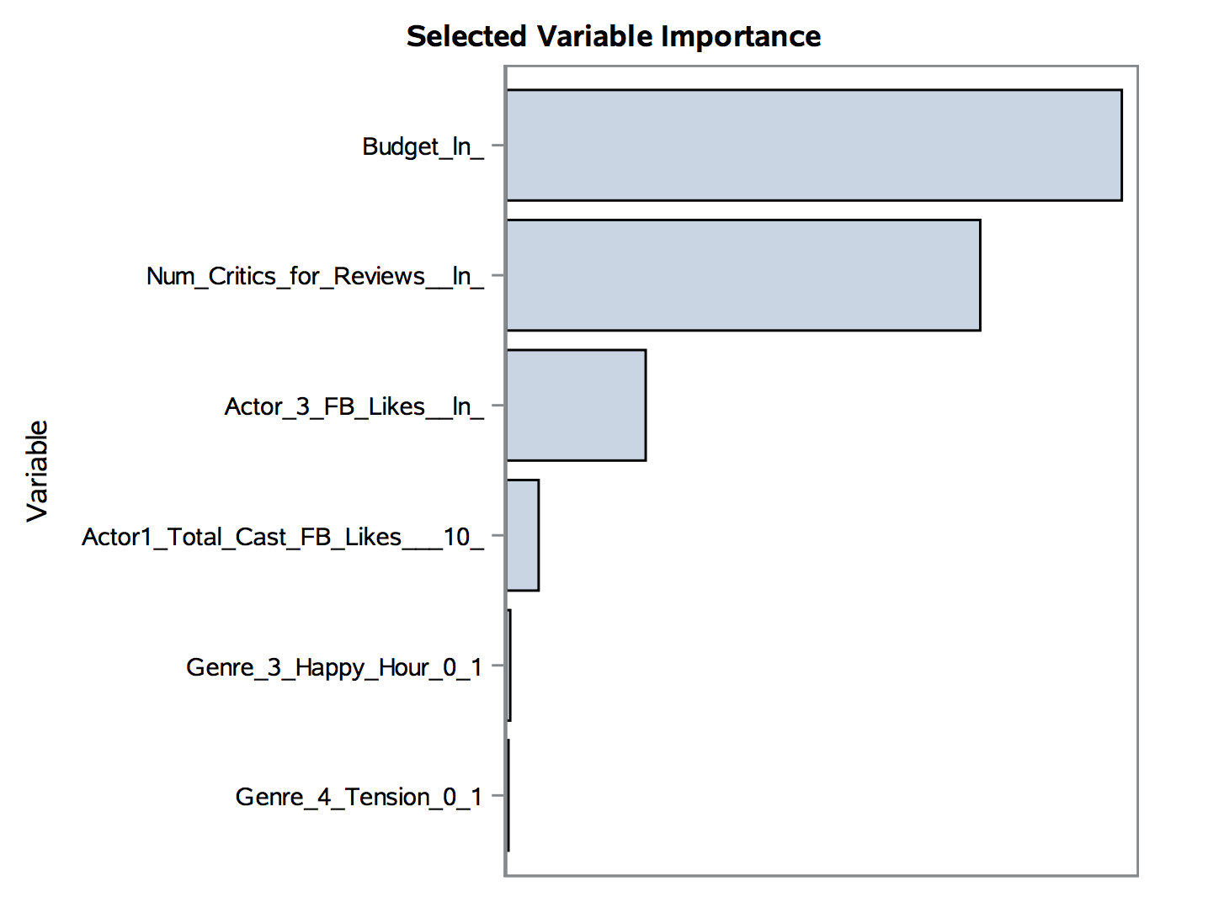
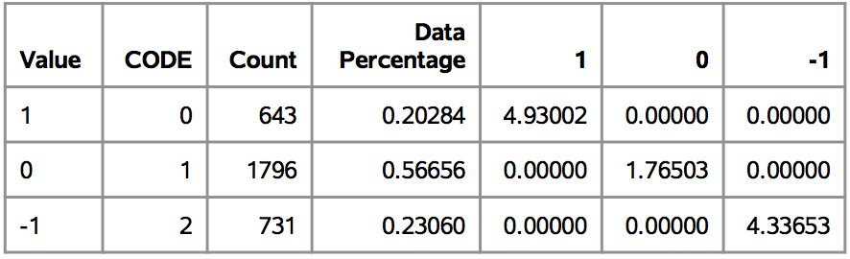
Gross Box Office Rapid predictive modeler
Definition of Target Classes
1 ：Gross Box > $70,000,000 (top 20% of dataset)
0 ：Gross Box in [$1,000,000, $70,000,000]
-1：Gross Box < $1,000,000 (last 23% of dataset)
Model Summary

Slide 8
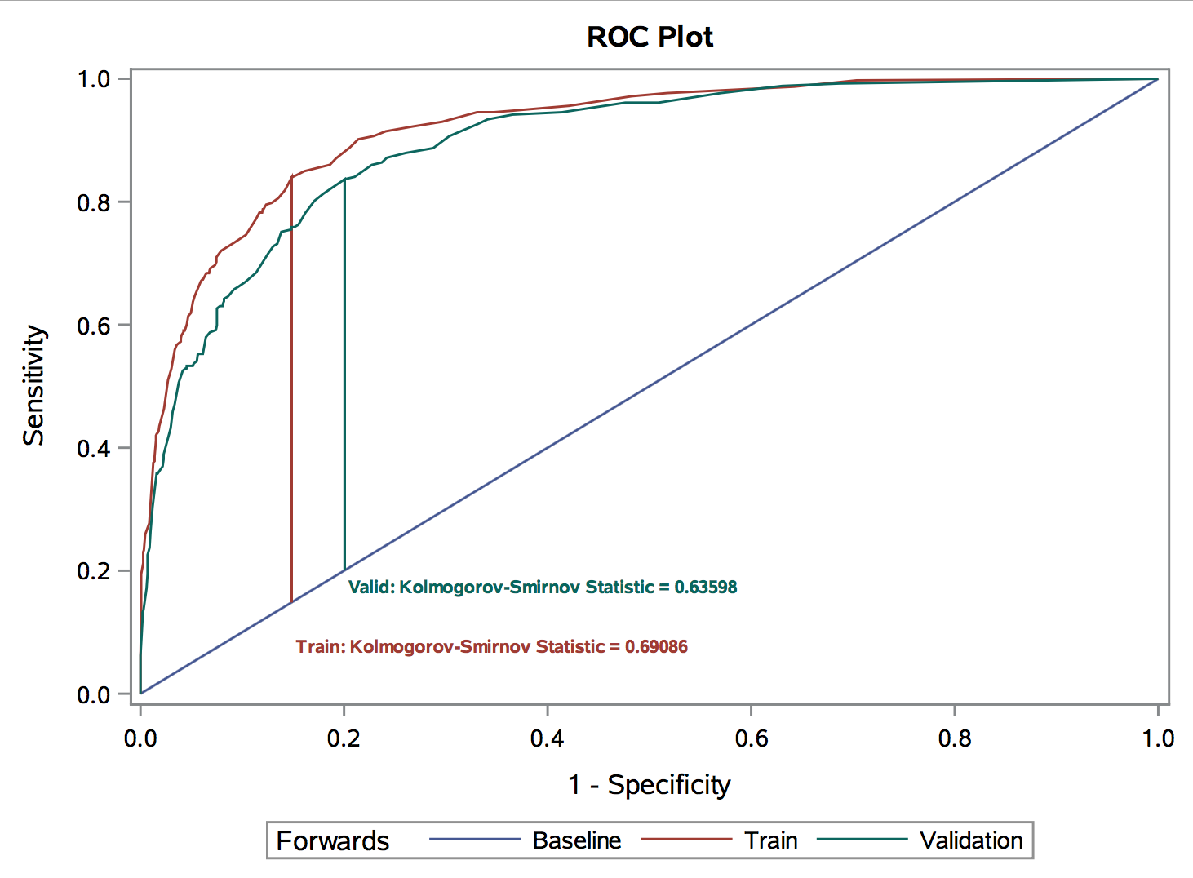
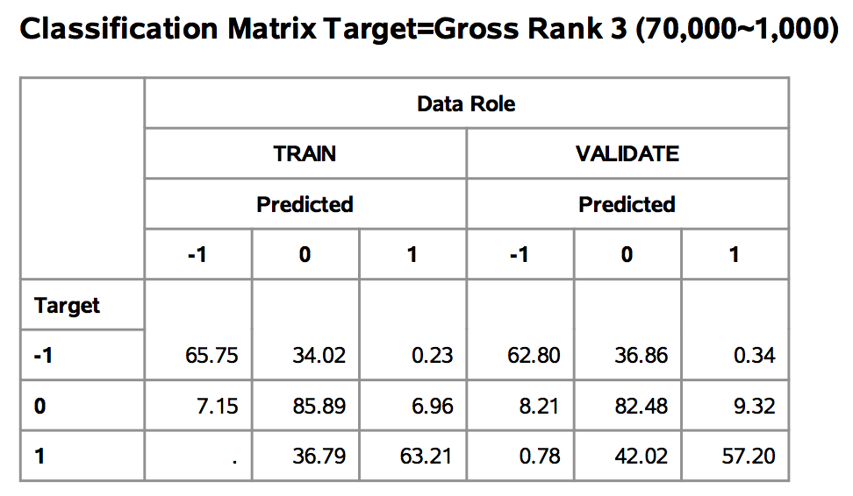
Gross Box Office Rapid predictive modeler
Train: Area under the curve : 0.9190
Validation: Area under the curve : 0.8960
Notes:
Eva will talk about IMDB score in detail

Slide 9
IMDB Binary logistic Regression results
Highest IMDB Movie
Threshold: IMDB Score> 7.5(top 14% of dataset)
Association of Predicted Probabilities and Observed Responses
Percent Concordant | 83.9 | Somers' D | 0.679
Percent Discordant | 16.1 | Gamma | 0.679
Percent Tied | 0.0 | Tau-a | 0.162
Pairs | 1201200 | c | 0.839

Slide 10
IMDB RPM Results
Definition of Target Classes
1 ：IMDB Score > 7.5(top 14% of dataset)
0 ：5.5<IMDB Score < 7.5( 68% of dataset)
-1：IMDB Score < 5.5(last 18% of dataset)
MODEL SUMMARY
MODEL SUMMARY
Property | Value
Input Data Source | MYLIB.IMDB1
Target Variable | IMDB RANK 2 (3 levels, 7.5, 5.5)
Event Level | 1
Observations | 3170
Original Variables | 51
Selected Variables | 10
Value | CODE | Count | Data Percentage | 1 | 0 | -1
1 | 0 | 440 | 0.13880 | 7.20455 | 0.00000 | 0.00000
0 | 1 | 2150 | 0.67823 | 0.00000 | 1.47442 | 0.00000
-1 | 2 | 580 | 0.18297 | 0.00000 | 0.00000 | 5.46552

Slide 11
IMDB RPM Results
(20%, 3.6)

Slide 12
IMDB RPM Results
Statistic | Train | Validation
Akaike's Information Criterion | 2516.7198 | .
Average Squared Error | 0.1256 | 0.1383
Average Error Function | 0.4177 | 0.4706
Maximum Absolute Error | 0.9983 | 0.9992
Mean Squared Error | 0.1279 | 0.1383
Sum of Frequencies | 1900.0000 | 1270.0000
Root Average Square Error | 0.3544 | 0.3718
Root Mean Squared Error | 0.3577 | 0.3718
Schwarz's Bayesian Criterion | 2941.2272 | .
Sum of Square Errors | 716.0957 | 526.7332
Misclassification Rate | 0.2737 | 0.3008
Roc Index | 0.8700 | 0.8020
Gini Coefficient | 0.7410 | 0.6050
Kolmogorov-Smirnov Statistic | 0.5960 | 0.4900
Kolmogorov-Smirnov Probability Cutoff | 0.1700 | .
Lift at 10% | 3.6364 | 3.0925
Cumulative Lift at 10% | 4.5076 | 3.5227
Captured Response at 10% | 18.1818 | 15.3409
Cumulative % Captured Response at 10% | 45.0758 | 35.2273

Slide 13
IMDB RPM results
variable attribute importance
 |  | Scorecard Points | Overall N | Overall % | IMDB RANK 2 (3 levels, 7.5, 5.5)
 |  |  |  |  | 0 |  | 1 |  | -1
 |  |  |  |  | N | % | N | % | N | %
Duration(Hour) | 1: LOW - 1.108 | 60.00 | 7.00 | 0.37 | 4.00 | 0.31 | 3.00 | 1.14 | 0.00 | 0.00
 | 2: 1.108 - 1.608 | 0.00 | 610.00 | 32.11 | 360.00 | 27.93 | 38.00 | 14.39 | 212.00 | 61.10
 | 3: 1.608 - 1.808 | 41.00 | 572.00 | 30.11 | 438.00 | 33.98 | 49.00 | 18.56 | 85.00 | 24.50
 | 4: 1.808 - 1.908 | 47.00 | 200.00 | 10.53 | 153.00 | 11.87 | 24.00 | 9.09 | 23.00 | 6.63
 | 5: 1.908 - 2.025 | 64.00 | 179.00 | 9.42 | 134.00 | 10.40 | 34.00 | 12.88 | 11.00 | 3.17
 | 6: 2.025 - 2.392 | 75.00 | 247.00 | 13.00 | 164.00 | 12.72 | 70.00 | 26.52 | 13.00 | 3.75
 | 7: 2.392 - HIGH | 113.00 | 85.00 | 4.47 | 36.00 | 2.79 | 46.00 | 17.42 | 3.00 | 0.86
Director FB Likes (ln) | 1: LOW - 3.902 | 0.00 | 619.00 | 32.58 | 417.00 | 32.35 | 33.00 | 12.50 | 169.00 | 48.70
 | 2: 3.902 - 4.052 | 11.00 | 360.00 | 18.95 | 222.00 | 17.22 | 71.00 | 26.89 | 67.00 | 19.31
 | 3: 4.052 - 4.61 | 13.00 | 206.00 | 10.84 | 154.00 | 11.95 | 18.00 | 6.82 | 34.00 | 9.80
 | 4: 4.61 - 6.409 | 14.00 | 565.00 | 29.74 | 413.00 | 32.04 | 85.00 | 32.20 | 67.00 | 19.31
 | 5: 6.409 - HIGH | 37.00 | 150.00 | 7.89 | 83.00 | 6.44 | 57.00 | 21.59 | 10.00 | 2.88
Num Critics for Reviews (ln) | 1: LOW - 0.347 | 80.00 | 21.00 | 1.11 | 9.00 | 0.70 | 6.00 | 2.27 | 6.00 | 1.73
 | 2: 0.347 - 4.363 | 0.00 | 454.00 | 23.89 | 259.00 | 20.09 | 21.00 | 7.95 | 174.00 | 50.14
 | 3: 4.363 - 5.228 | 55.00 | 693.00 | 36.47 | 511.00 | 39.64 | 51.00 | 19.32 | 131.00 | 37.75
 | 4: 5.228 - 5.953 | 110.00 | 582.00 | 30.63 | 431.00 | 33.44 | 116.00 | 43.94 | 35.00 | 10.09
 | 5: 5.953 - 6.168 | 133.00 | 89.00 | 4.68 | 58.00 | 4.50 | 30.00 | 11.36 | 1.00 | 0.29
 | 6: 6.168 - HIGH | 332.00 | 61.00 | 3.21 | 21.00 | 1.63 | 40.00 | 15.15 | 0.00 | 0.00

Slide 14
IMDB RPM results
classification matrix
 | Data Role
 | TRAIN |  |  | VALIDATE
 | Predicted |  |  | Predicted
 | -1 | 0 | 1 | -1 | 0 | 1
Target | 31.70 | 67.72 | 0.58 | 31.76 | 67.38 | 0.86
-1
0 | 5.51 | 91.31 | 3.18 | 5.23 | 88.97 | 5.81
1 | 1.14 | 63.64 | 35.23 | 1.70 | 71.02 | 27.27
model selection based on model node
Selected Model | Model Node | Model Description | Target Label | Train: Akaike's Information Criterion | Train: Lift | Valid: Lift
Y | Reg3 | Backwards | IMDB RANK 2 (3 levels, 7.5, 5.5) | 2516.72 | 3.63636 | 3.09253
 | Reg2 | Forwards | IMDB RANK 2 (3 levels, 7.5, 5.5) | 2541.22 | 3.33333 | 2.78710
 | Ensmbl | Ensemble_Champion | IMDB RANK 2 (3 levels, 7.5, 5.5) | . | 3.33333 | 3.09253
 | Reg | Main Effects Regression | IMDB RANK 2 (3 levels, 7.5, 5.5) | 2552.49 | 3.10606 | 2.63438

Slide 15
Thanks

